Slide 1
Section 5.6
Complex Zeros;
Fundamental Theorem of Algebra
Copyright © 2012 Pearson Education, Inc. Publishing as Prentice Hall.

Slide 2

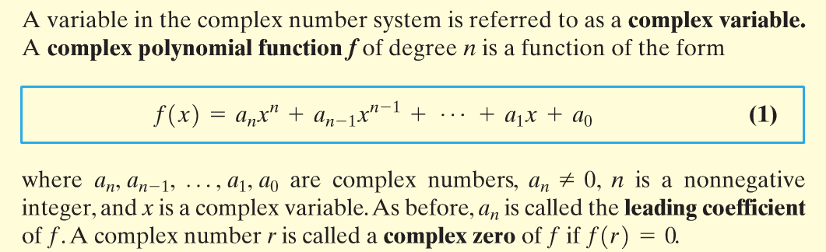

Copyright © 2012 Pearson Education, Inc. Publishing as Prentice Hall.

Slide 3

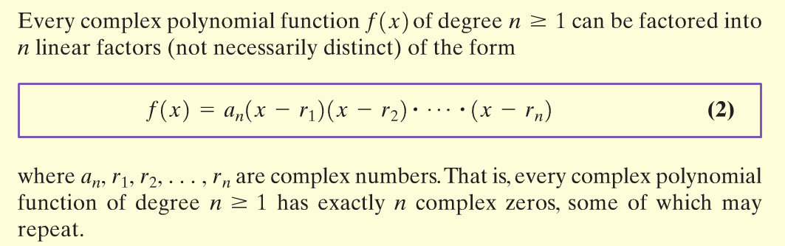
Copyright © 2012 Pearson Education, Inc. Publishing as Prentice Hall.

Slide 4
Copyright © 2012 Pearson Education, Inc. Publishing as Prentice Hall.

Slide 5



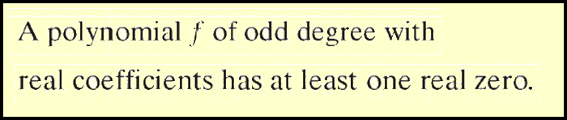
Copyright © 2012 Pearson Education, Inc. Publishing as Prentice Hall.

Slide 6

A polynomial of degree 5 whose coefficients are real numbers has the zeros –2, –3i, and 2 + 4i. Find the remaining two zeros.
Since f has coefficients that are real numbers, complex zeros appear as conjugate pairs. It follows that 3i, the conjugate of –3i, and 2 – 4i, the conjugate of 2 + 4i, are the two remaining zeros.
Copyright © 2012 Pearson Education, Inc. Publishing as Prentice Hall.

Slide 7
Copyright © 2012 Pearson Education, Inc. Publishing as Prentice Hall.

Slide 8
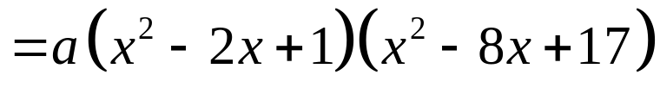
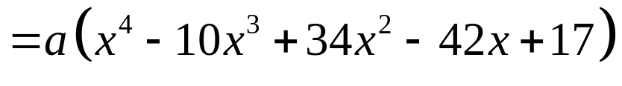
Find a polynomial f of degree 4 whose coefficients are real numbers and that has the zeros 1, 1, 4 + i.
Since 4 + i is a zero, by the Conjugate Pairs Theorem, 4 – i is also a zero.
By the factor theorem:
Copyright © 2012 Pearson Education, Inc. Publishing as Prentice Hall.

Slide 9
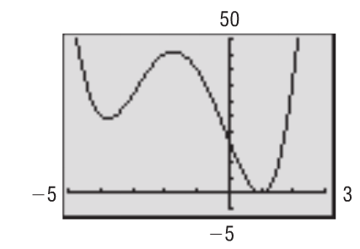


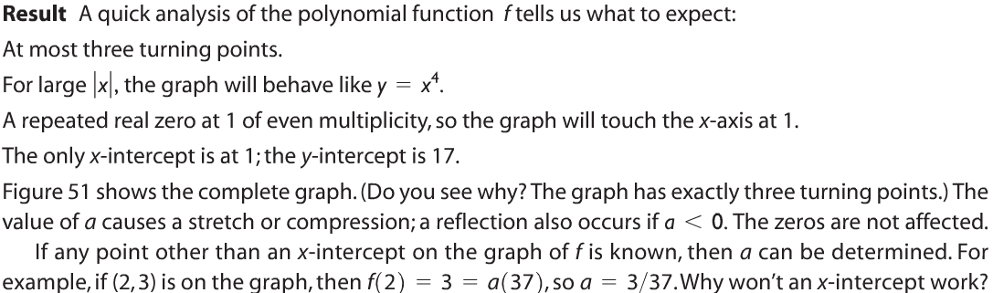
Figure 51
Copyright © 2012 Pearson Education, Inc. Publishing as Prentice Hall.

Slide 10
Copyright © 2012 Pearson Education, Inc. Publishing as Prentice Hall.

Slide 11
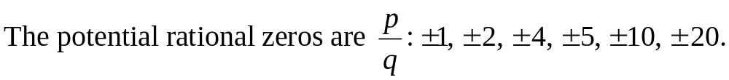
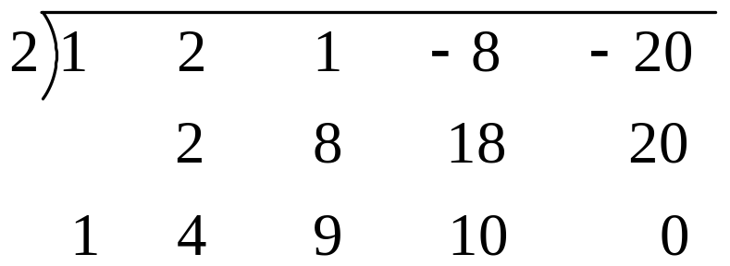
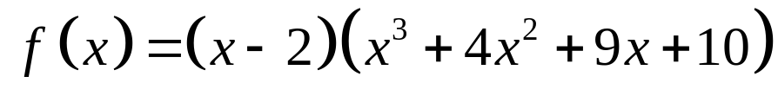
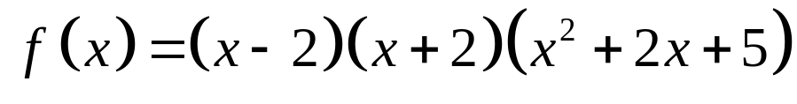
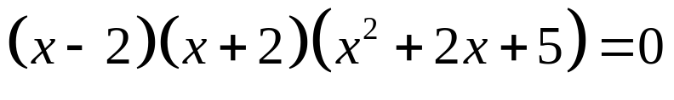
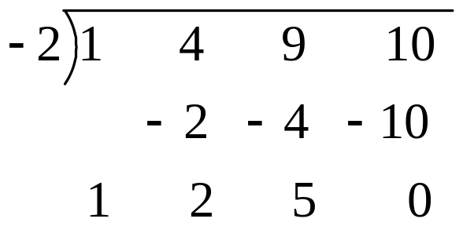
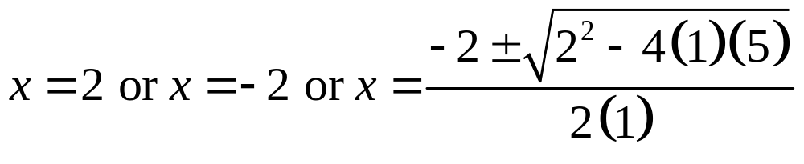
Step 1: The degree of f is 4 so there will be 4 complex zeros.
Step 2:
Copyright © 2012 Pearson Education, Inc. Publishing as Prentice Hall.

Slide 12
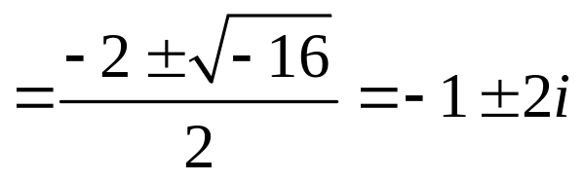
Copyright © 2012 Pearson Education, Inc. Publishing as Prentice Hall.

